Slide 1

Assessing Efficacy of High and Low Level Features in Niche Music Genre Classification
Noman Bashir
Vincent Rossi

Slide 2


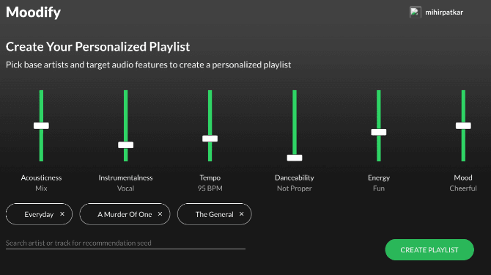
SPOTIFY AND MUSIC RECOMMENDATION
SPOTIFY HAS MANY PRE-EXTRACTED FEATURES THAT THAT ARE USED TO RECOMMEND MUSIC TO USERS

Slide 3
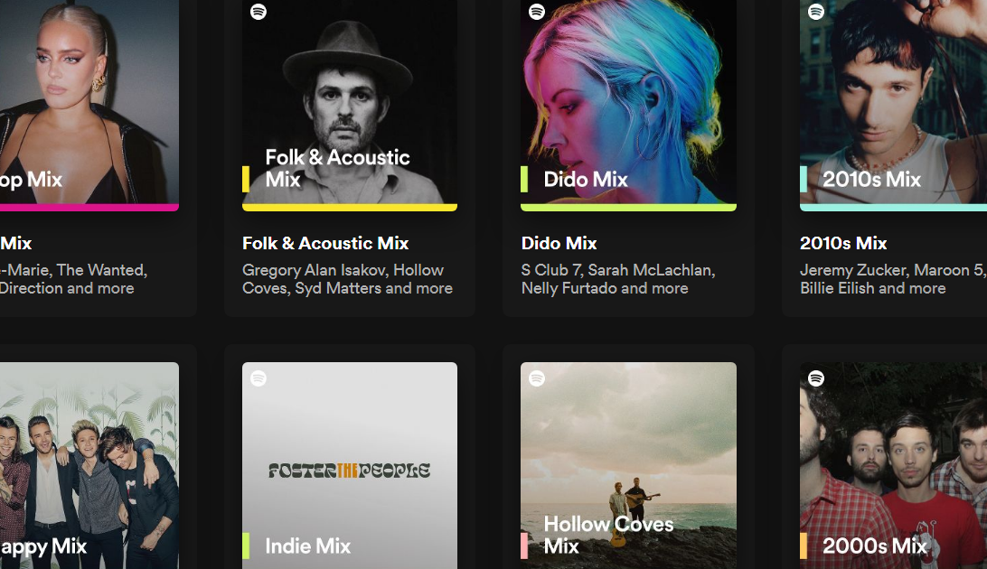

NICHE GENRES & MUSIC RECOMMENDATION
GUY I LISTEN TO SOMETIMES
MY RECOMMENDATIONS
URDU ARTIST
GENRE: QAWWALI

Slide 4
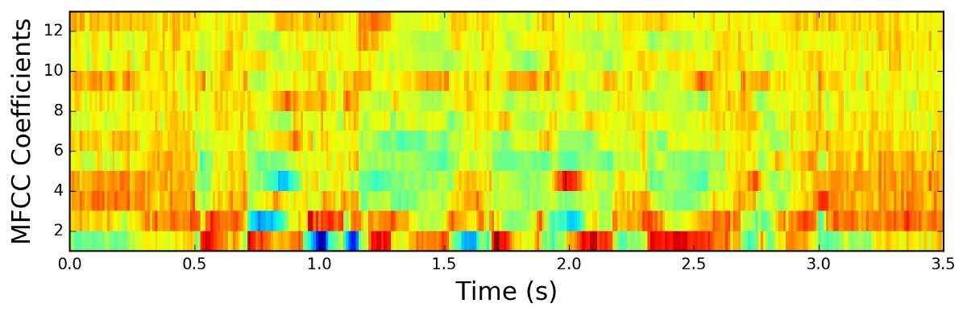
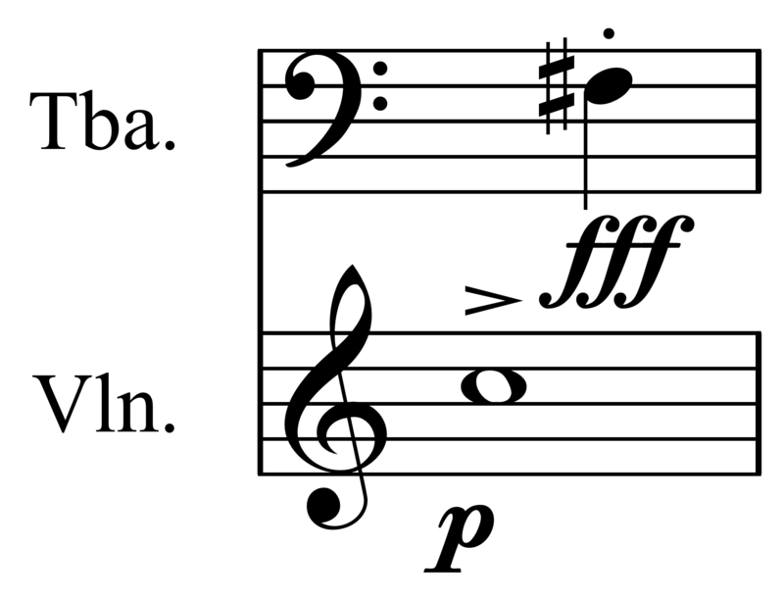


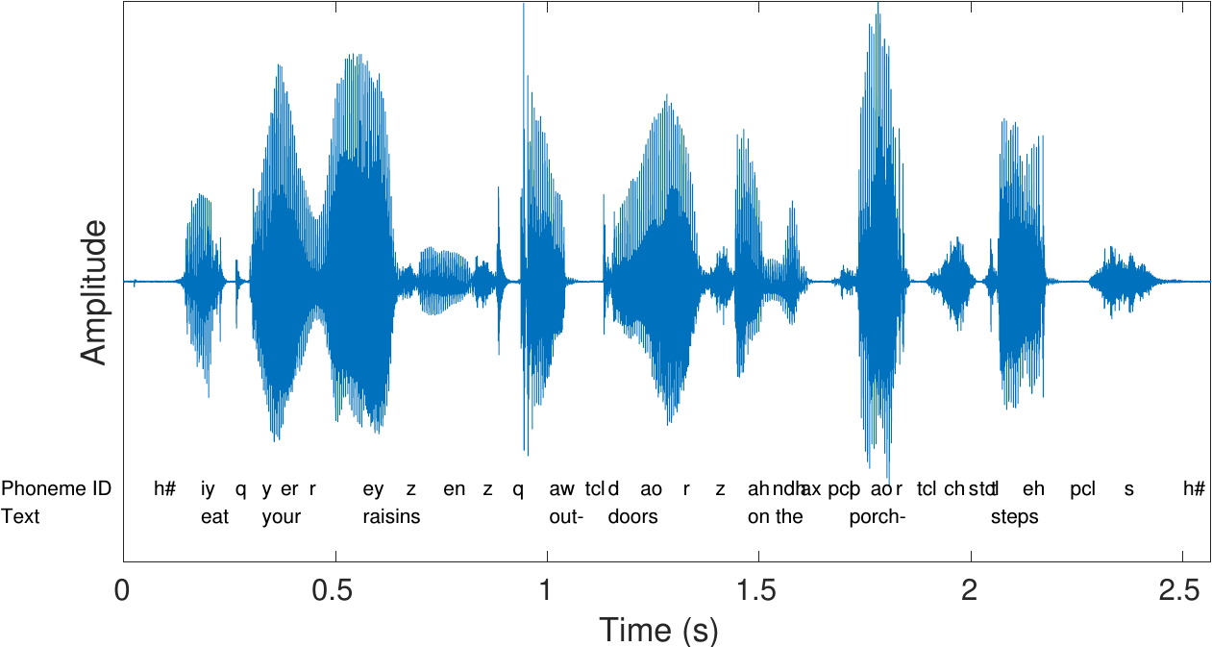
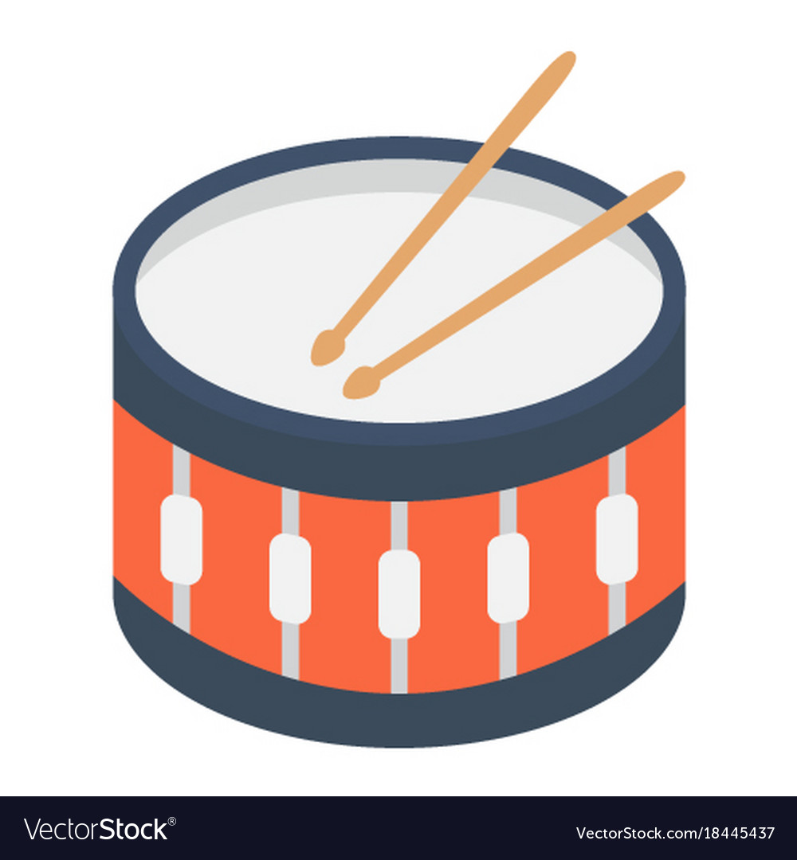
HOW IS MUSIC CLASSIFIED?
HIGH LEVEL FEATURES
LOW LEVEL FEATURES

Slide 5
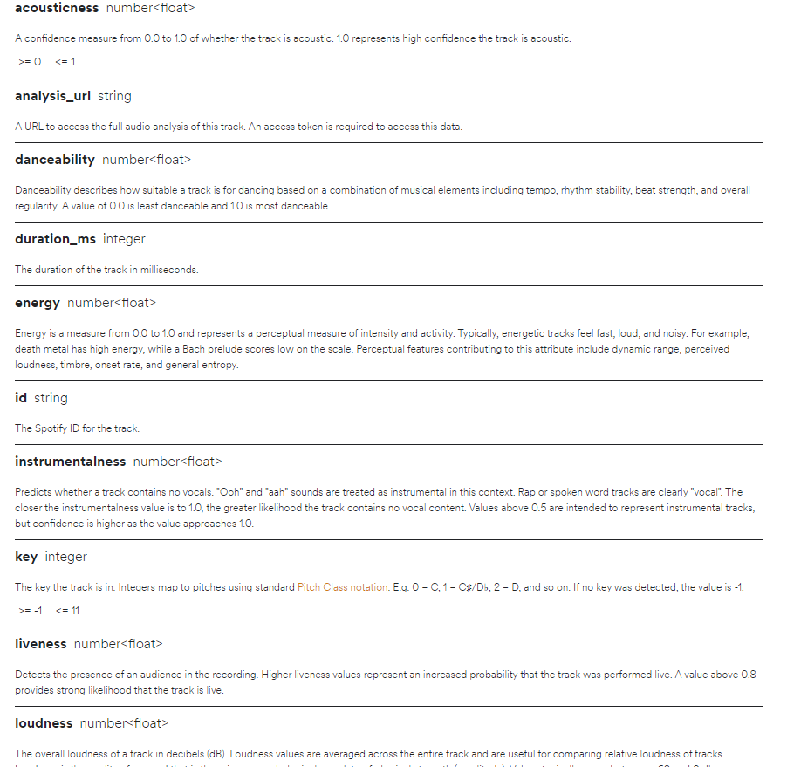
SPOTIFY FEATURES
ALL HIGH LEVEL FEATURES

Slide 6
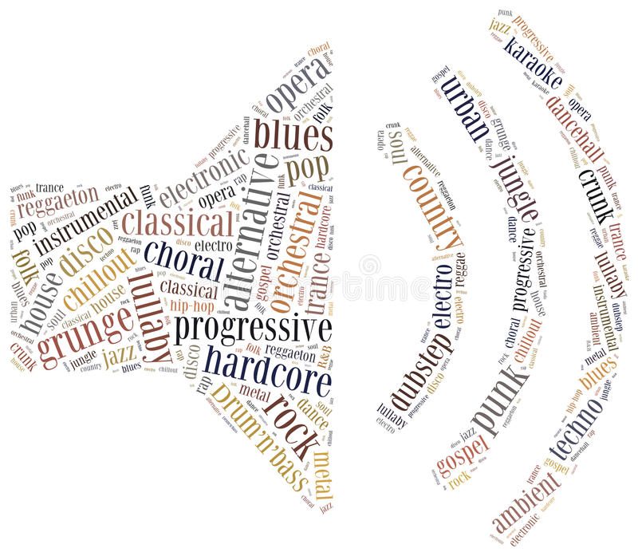
QUESTION: GENRE CLASSIFICATION
ARE GENRES IN LESS-SPOKEN LANGUAGES FEW PEOPLE LISTEN TO MORE DIFFICULT TO CLASSIFY USING HIGH LEVEL FEATURES THAN POPULAR GENRES LIKE POP/ROCK/RAP?

Slide 7
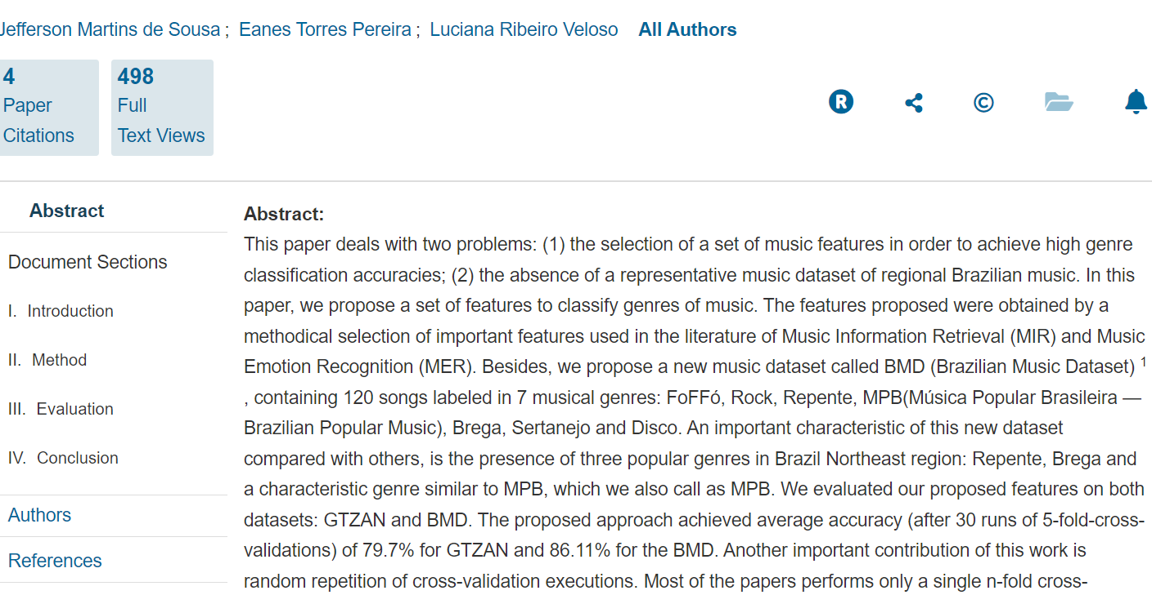
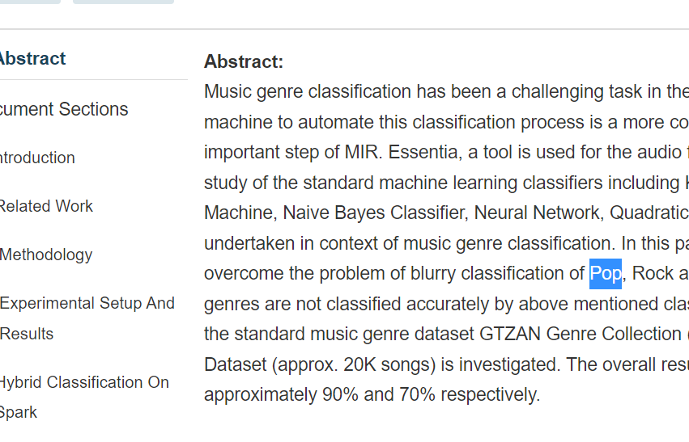
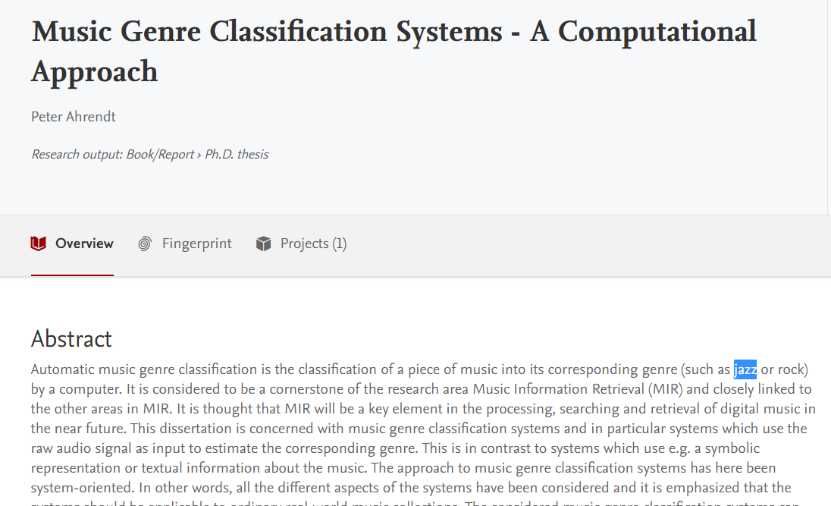
WHAT DOES THE RESEARCH SAY?
MOST RESEARCH COVERS POPULAR GENRES EVEN IF THERE HAS BEEN MOVEMENT INTO NEWER GENRES

Slide 8

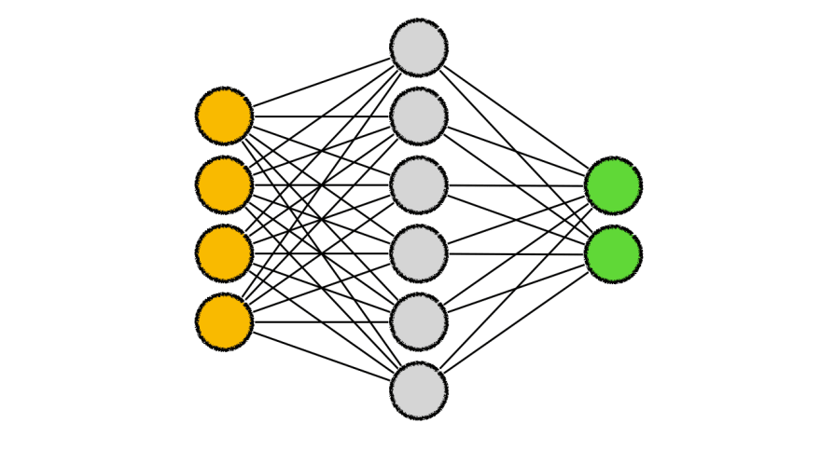


OUR IDEA – AN INVESTIGATION
Gather data using Spotify’s API including high level features including niche genres
Preprocess data extracting relevant features
Run SVM on high and low-level and compare accuracies for genres
Create and run CNN to see if accuracy improves on extracted features

Slide 9
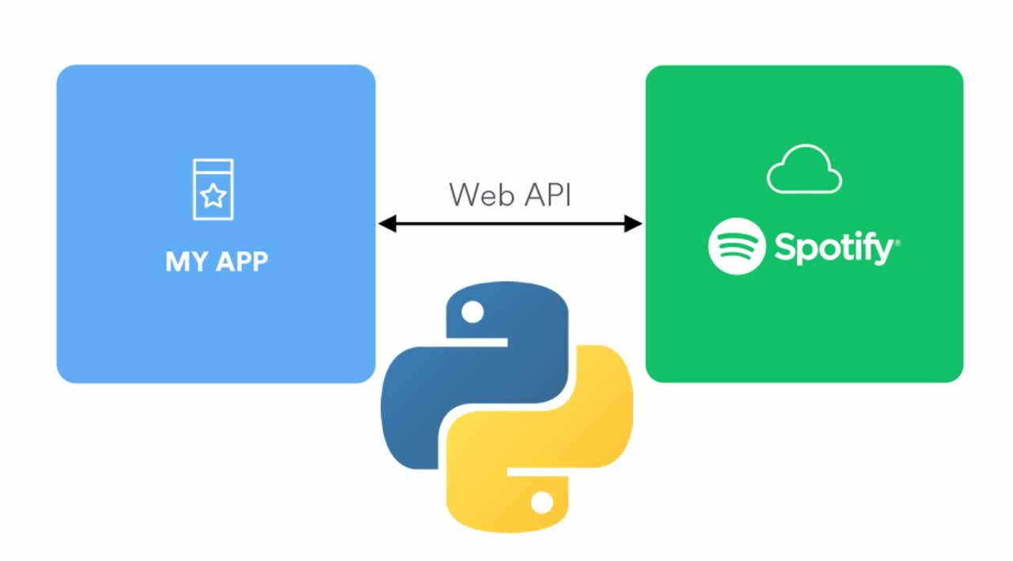
HOW? SPOTIPY API!
Use Google to get artists for genres
Use Spotipy + Spotify API and Developer Account to get Artist Details and Songs
Extract Spotify Features
Get Preview URL
Save previews and files

Slide 10
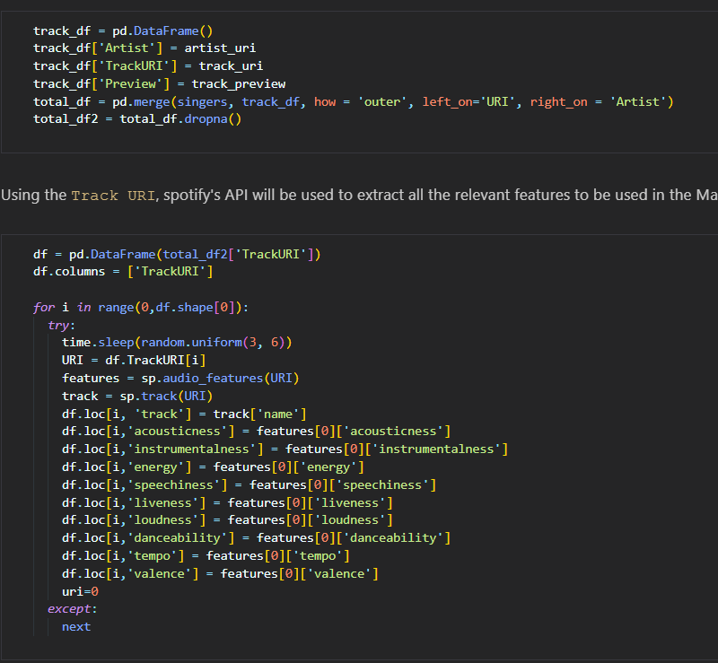


BRIEF OVERVIEW
FILES CREATED
SUBSAMPLED.CSV
3000 30s .mp3 files

Slide 11
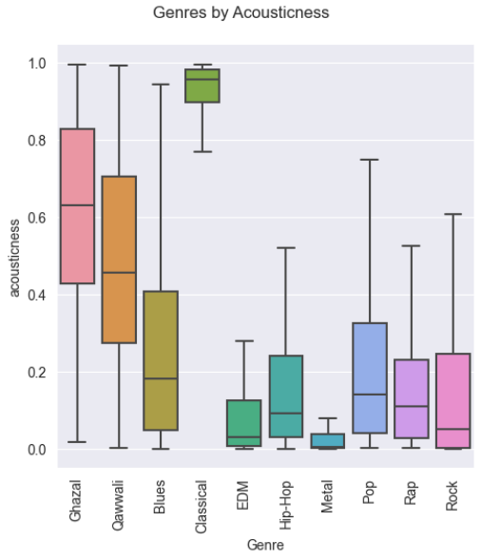
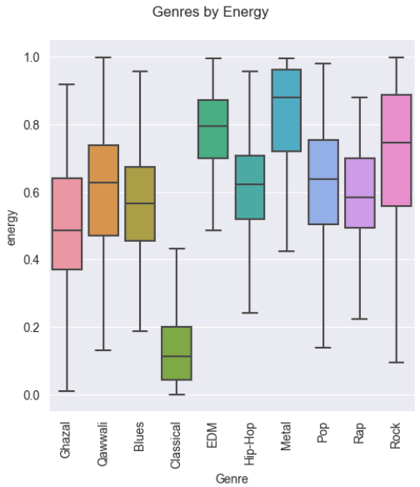
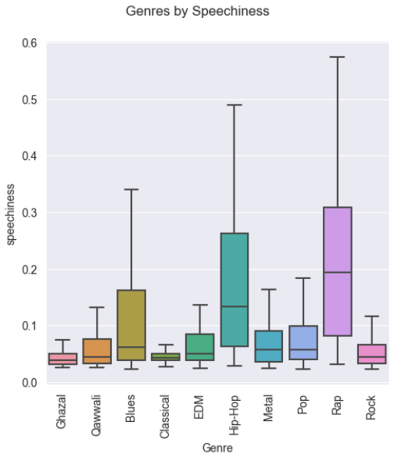
BASIC EDA ~ 2. EDA.ipynb

Slide 12
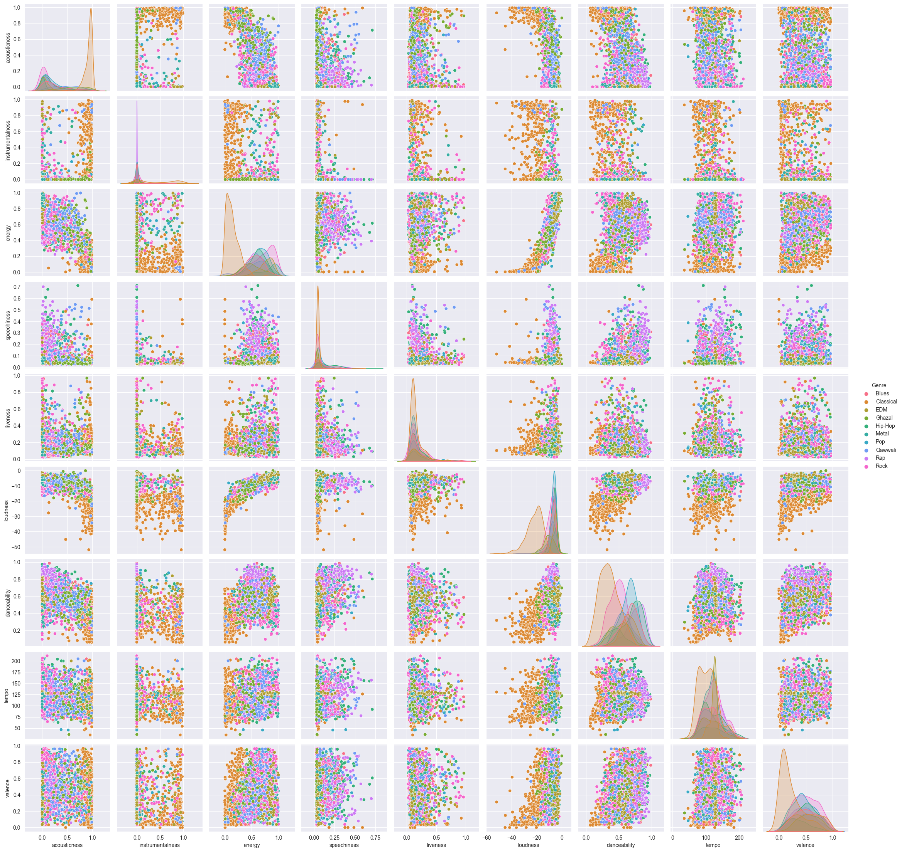
BASIC EDA
THE ORANGE ONE IS “CLASSICAL”. IT’S THE ONLY ONE THAT SEEMS EASILY SEPARABLE

Slide 13

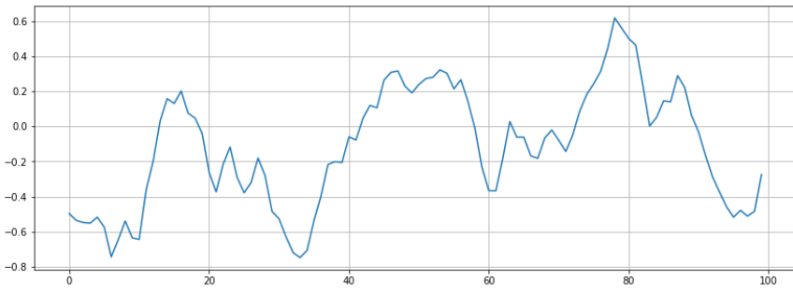

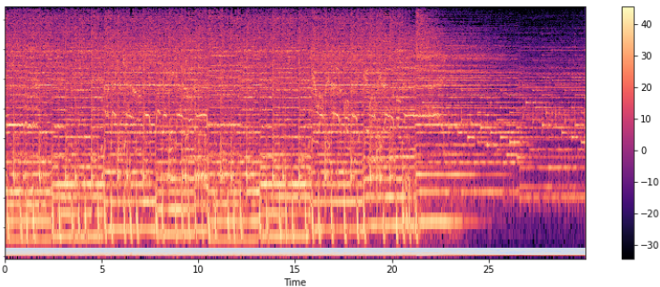
DATA PREPROCESSING USING LIBROSA
ZERO CROSSING RATE
FILES CREATED
MUSICDATA.CSV
SPECTOGRAM
DATA.JSON

Slide 14

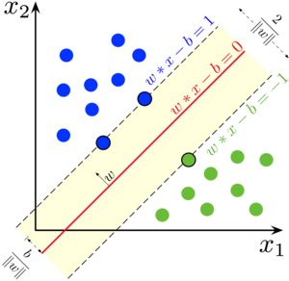
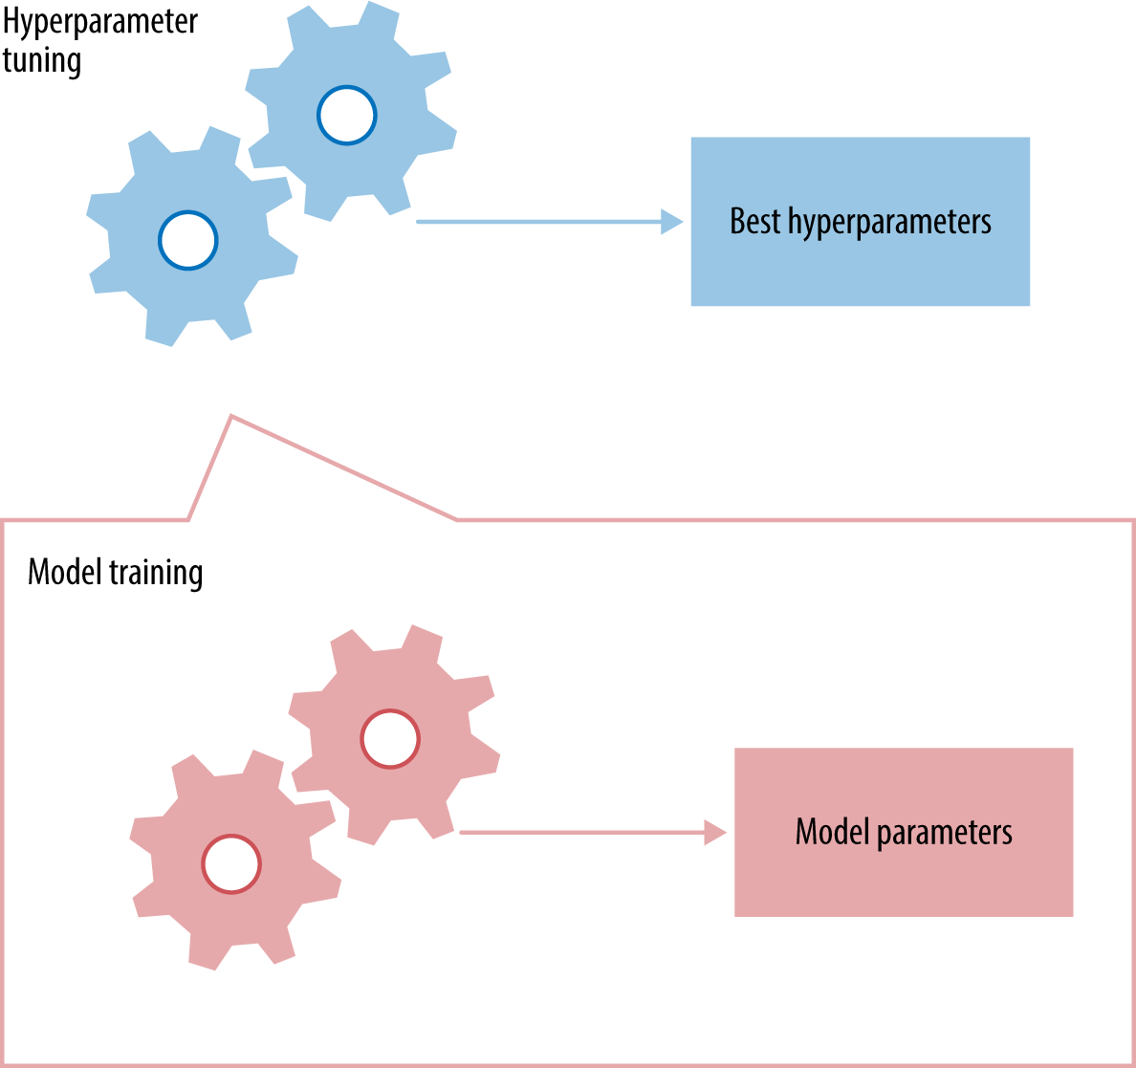
BASIC SVM ~ 3 and 5.IPYNB

Slide 15


CNN ~ 6. CNN.IPYNB

Slide 16
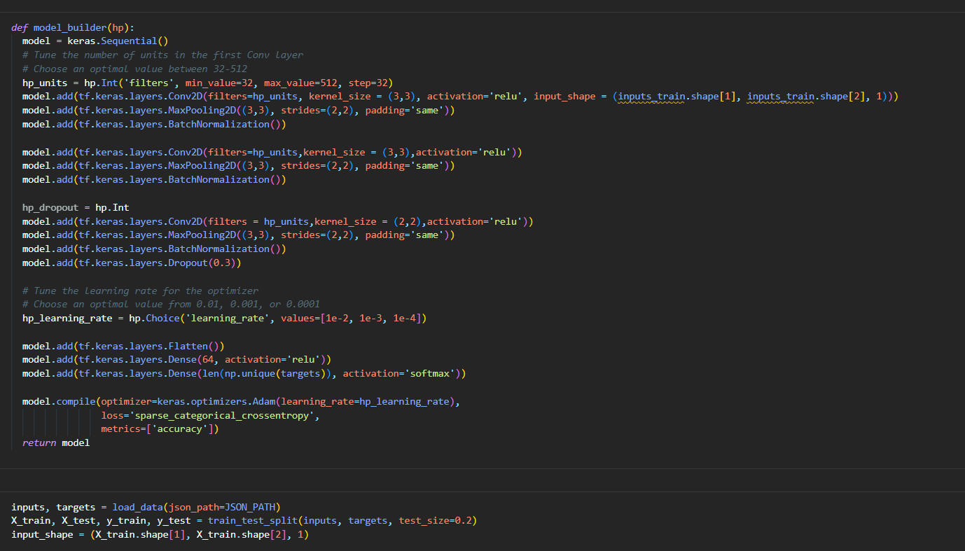
CNN ~ 6. CNN.IPYNB
BASICALLY, 3 LAYERS. STRIDE OF (2,2). KERNEL OF (3,3). TUNING OTHERS

Slide 17
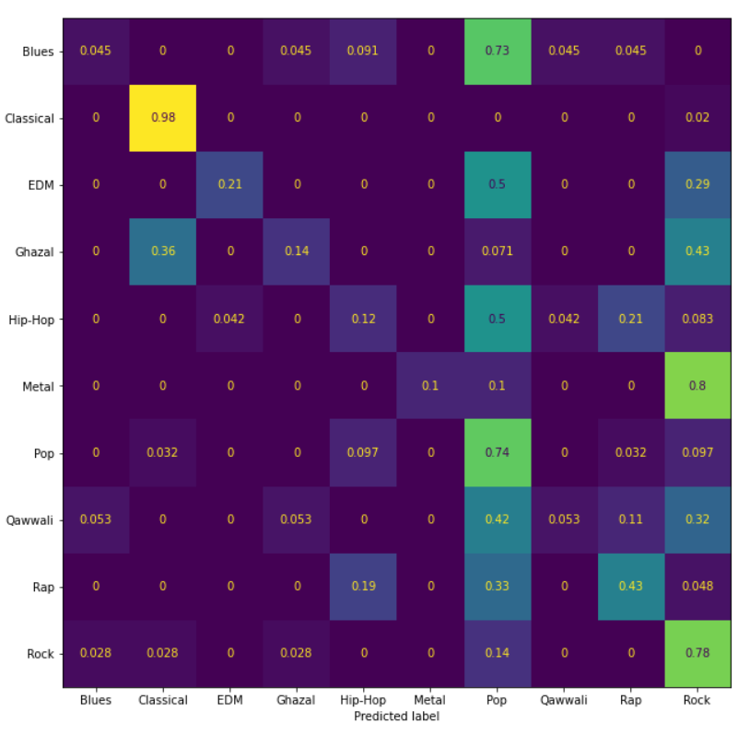
RESULTS – BASIC SVM
ACCURACY:
55%
QAWWALI NOT BEING PREDICTED WELL. BUT NO GENRE IS BEING PREDICTED WELL.

Slide 18
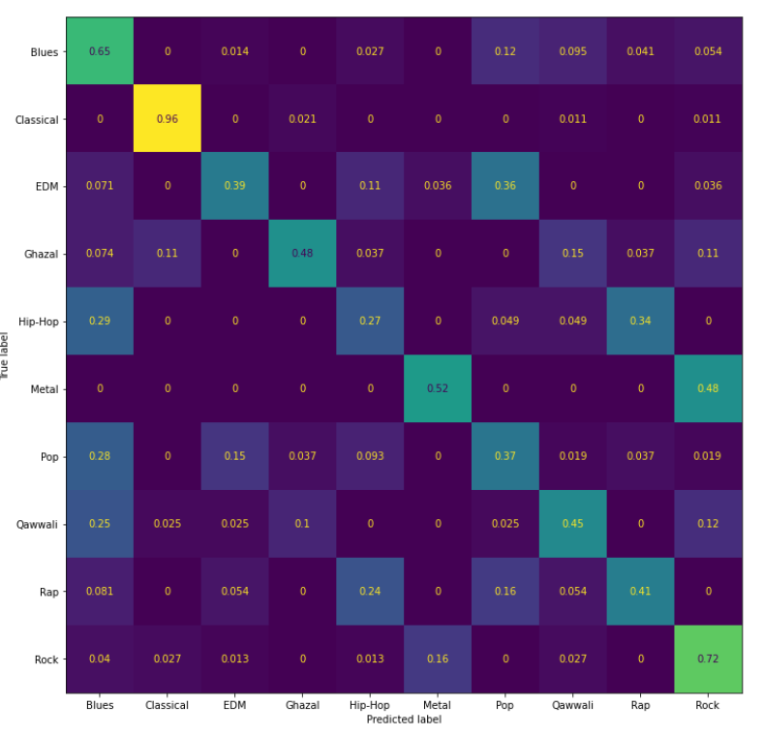
RESULTS – EXTRACTED FEATURE SVM
ACCURACY:
59%
IMPROVEMENT IN MOST GENRES. LOSS OF ACCURACY IN POP

Slide 19
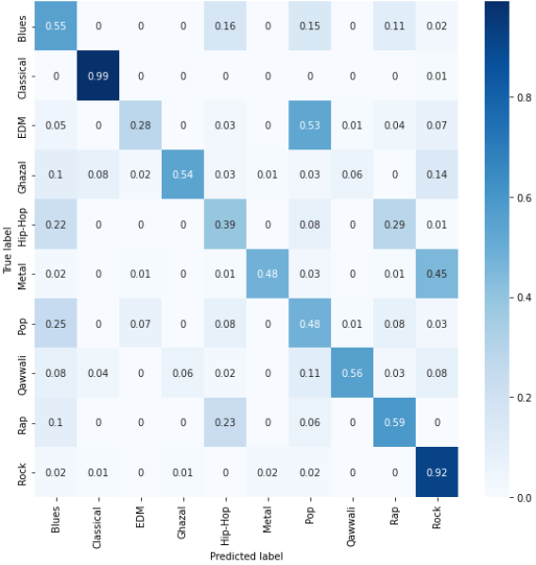
RESULTS - CNN
ACCURACY:
65%
CAN SEE LINKS BETWEEN GENRES NOW

Slide 20
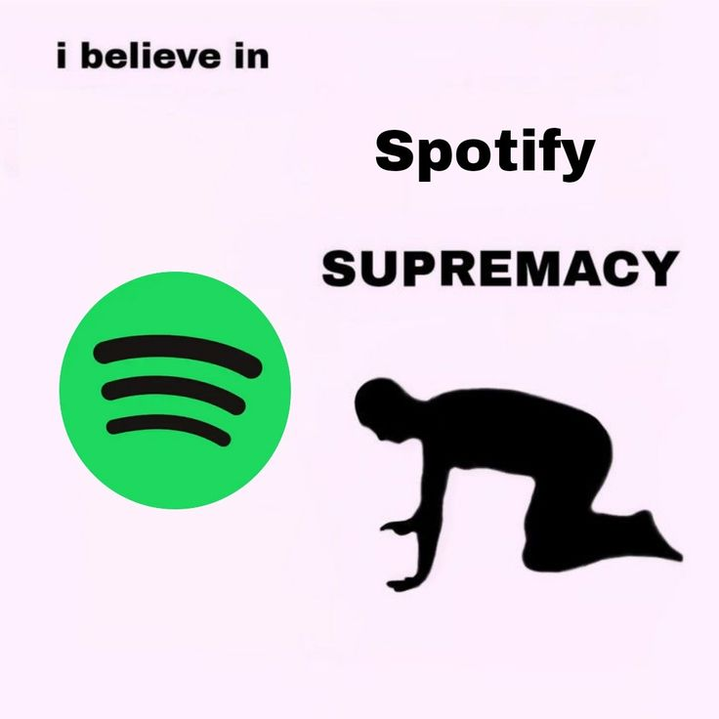
CONCLUSION AND LIMITATIONS
LIMITATIONS:
Only one language considered
Possibility of multiple genres for one artist
Simple CNN
FUTURE RESEARCH:
More languages.
More genres
Better computational power

Slide 21
THANK YOU
Noman Bashir
Vincent Rossi

